Slide 1

InstantGMP™ PRO
Affordable. Paperless. Interactive. FDA Compliant Batch Management Software
Notes:
The staff at InstantGMP prepared the GMP for Dietary Supplements Compliance Series of presentations to focus on good manufacturing practices and GMP compliance for dietary supplements manufacturing. These are brought to you by our quality and manufacturing experts in the hope that it will help you avoid any GMP compliance issues in your shop. This presentation will address the flow of GMP processes.

Slide 2

Notes:
Opening Remarks
(thank everyone for taking this final step in their journey towards a better way of managing their records, resources and sanity!)
Thanks for DISCO access
(thank specific individuals for access and share something funny or insightful from the process. Explain what value they have already realized from this sales process and get them to say “Yes! We agree!”)
Overview of this demonstration
(“What I’m about to say will sound shocking but sometimes it’s easier to see the trees in the forest if you are looking down from a mountain rather than from within the forest itself! So, here is my statement: over the next several minutes we will journey through parallel Universes!
I bet you NEVER imagined you’d be time traveling today but this is no gimmick statement or crazy man talking here. Think of a movie scenario like Back to the Future or Star Trek or many other Hollywood examples. Now imagine the level of resources needed to time travel and possible consequences that if the tiniest thing was not done correctly how significant would the consequences be to return to the Present? I know this sounds outrageous but I promise when we reach the end of our parallel journey today all of this will indeed be revealed!”)

Slide 3
Introductions & Overview
Your Objectives: A review
What you do now – do it better!
How InstantGMPTM works!
Training & Validation
Implementation Options
InstantGMP instance (interactive)
      Logins & Roles
      Data Setup & Import
      Inventory Management
      Electronic Batch Records (MPR & BPR)
      Reports
Pricing
Options
Action Plan?
Close
10 mins
20 mins
10 mins
Notes:
Opening Remarks
(thank everyone for taking this final step in their journey towards a better way of managing their records, resources and sanity!)
Thanks for DISCO access
(thank specific individuals for access and share something funny or insightful from the process. Explain what value they have already realized from this sales process and get them to say “Yes! We agree!”)
Overview of this demonstration
(“What I’m about to say will sound shocking but sometimes it’s easier to see the trees in the forest if you are looking down from a mountain rather than from within the forest itself! So, here is my statement: over the next several minutes we will journey through parallel Universes!
I bet you NEVER imagined you’d be time traveling today but this is no gimmick statement or crazy man talking here. Think of a movie scenario like Back to the Future or Star Trek or many other Hollywood examples. Now imagine the level of resources needed to time travel and possible consequences that if the tiniest thing was not done correctly how significant would the consequences be to return to the Present? I know this sounds outrageous but I promise when we reach the end of our parallel journey today all of this will indeed be revealed!”)

Slide 4


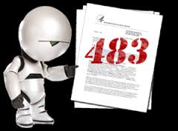



Living in the past can be stressful

Slide 5
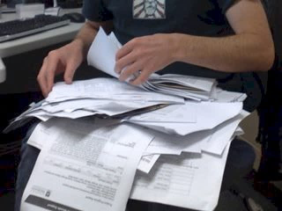



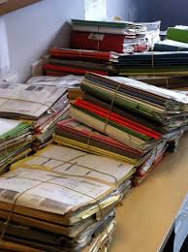
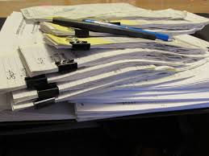
A better way . . .
What life is like now . . .
after InstantGMPTM

Slide 6


Answers at the speed of click!

Slide 7
About Us
Founded in 2004
Brain-child of Dr. Richard Soltero
  30 + years of experience in pharmaceutical, biotech and IT
  R&D leadership at Ciba-Geigy, Berlex, Johnson & Johnson
  Global VP at SmithKline Beecham and AAI
  Created systems to make GMP compliance easy
  Realized that cloud-based EBR could fill an unmet need
First affordable cloud-based EBR that meets Part 11 and FDA requirements

Slide 8
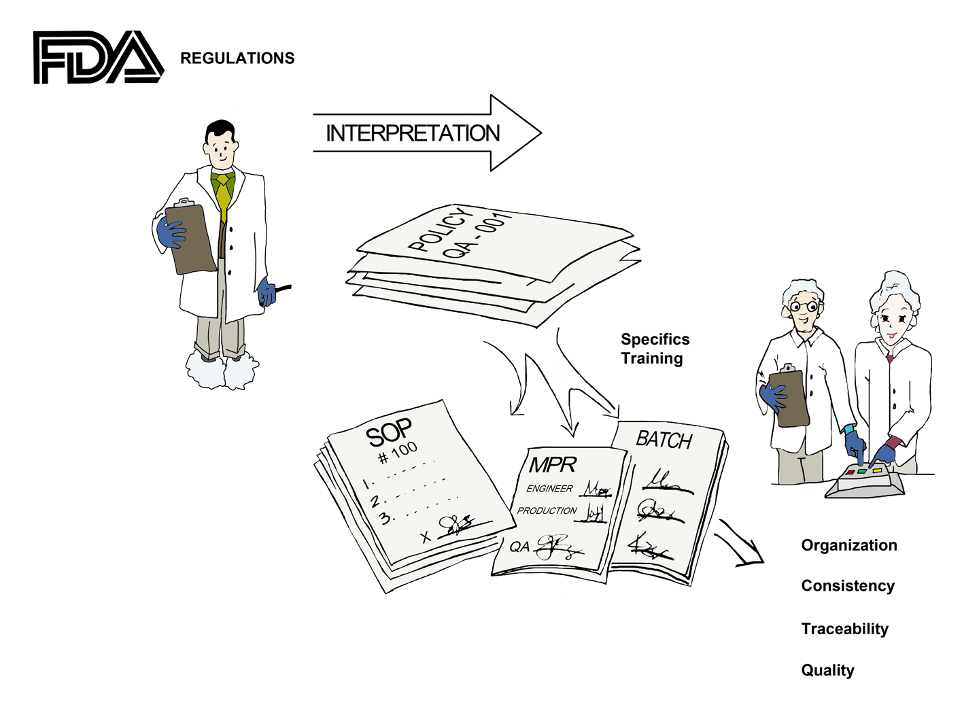
FDA Requires SOPs for GMP Compliance
Full Set
  105 SOPs and Policies
Core set
  30 SOPs and Policies cover InstantGMP™
Holding and Distribution Set
  65 SOPs and Policies for any Holding and Distribution companies
Notes:
Implementing a quality system for Good Manufacturing Practices is required by the FDA. Their regulations are written in very general terms so they have to interpreted for each type of manufacturing operation. The interpretation shows up in the policies and standard operating procedures that are written by or for the manufacturing company. The electronic batch record software and SOPs from InstantGMP provide the foundation for a total quality system.

Slide 9
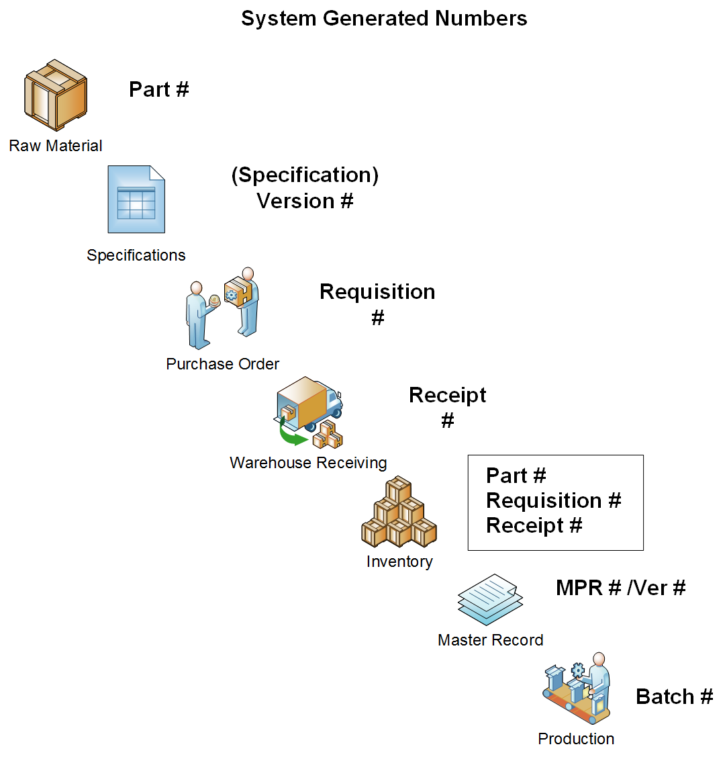
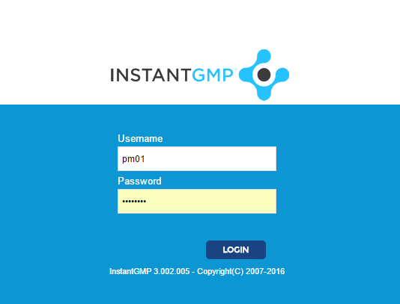
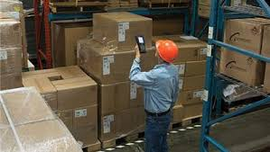
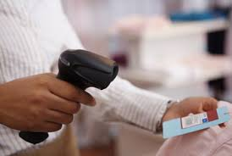
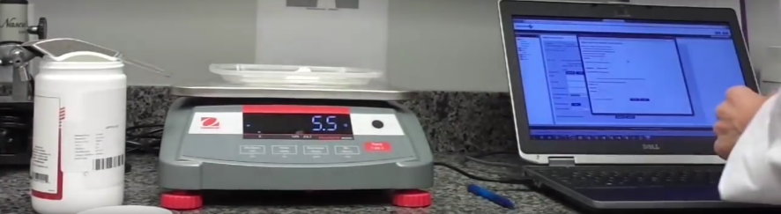
Log in
2. Barcode Wand
3. Scan & Get Weight
(integrated scales via IoT)

Slide 10
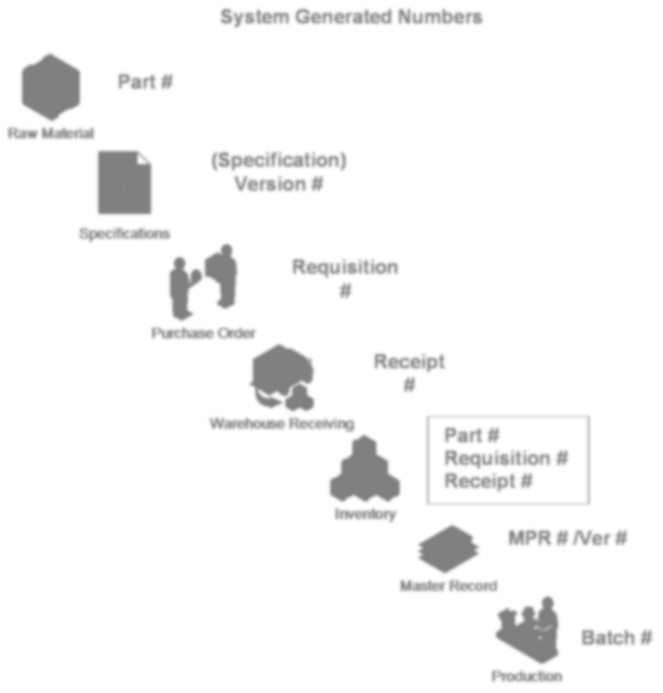

Your Company
Secure Cloud
Digital.
Automated.
Traceable.
Visible.
Compliant!

Slide 11
What’s Included
Software Training included with license–structured, interactive program
  Orientation - An overview presentation of the software, the regulations, and explanation of the software's workflows.
  Software Training - A section-by-section tutorial given to the Project Manager and Quality Manager chosen by the customer
  Training videos with step by step instructions through all modules available on-line

Slide 12
Validation Support
Validation Package
  Validation Summary Reports
  OQ Protocol and Test Scripts
  Interim OQ Summary Reports
Validation complies with:
  21 CFR part 11: Electronic Documentation and Electronic Signatures
  Good Automated Manufacturing Practice (GAMP 5)
  FDA: General Principles of Software Validation

Slide 13
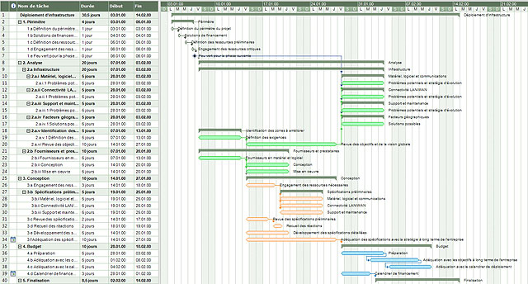

Customized Guidance – (optional service)
  Implementation Program
  Process Evaluation and Consulting – review of your company’s current production workflows
  Map company specific batch production related work flows
  Plan out the transition from manual systems to electronic batch records
  Create company specific Master Production Records (MPR)
  Guide the implementation and roll out to all users

Slide 14
Questions?

Slide 15
Your Company
Secure Cloud
Digital.
Automated.
Traceable.
Visible.
Compliant!

