Slide 1


Slide 2
<
>
WHAT WE WANT
TO ACCOMPLISH
To help Puerto Rico rebuild as an innovation-driven economy & emerge from its fiscal & humanitarian crisis.
Notes:
Make life simple to improve outcome for governments. Go to estonia and UK and talk about the ‘big prize’ of government as a platform. Platform infrastructure for multiple services!
Geolocation data for organization.
Design patterns
simplicity
End with the big prize
Workshop
Procurement and how we transform it
Simplicity and mobile first, design patterns
Recruitment
ID ecosystem - what do we use and what is politically acceptable
Internet-era Service Design - examples of how you can me the most of having a multi-disciplinary approach redesigning services using internet era approaches.
Talking about SERVICE DESIGN
Registeres and data as an infrasctructure! Land ownership registry!!! Doing that and the capabilities in a country
Identity - worries Tom because it’s hard to do - gov gives you an ID and tests you the ID or you have self-sovereignID - accept starndard third party id issuance. Where are we on this journey?
Lets push for this? I have Key people!!!
Richard Carrion support?
Honduras land registry!
Use blockchain to explore the land registry
Notion of using criptography to prove ownership of things is good for land and company registry
Data as infrasctructure - the first country to go for this!!!!

Slide 3
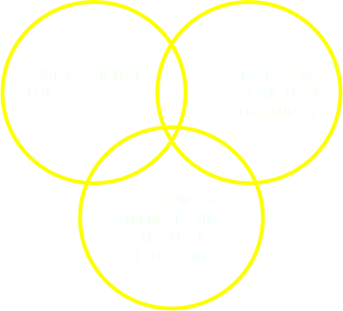
<
>
THE STRATEGY
Raise awareness on the importance of rebuilding Puerto Rico through well a structured digital strategy by:
Notes:
Make life simple to improve outcome for governments. Go to estonia and UK and talk about the ‘big prize’ of government as a platform. Platform infrastructure for multiple services!
Geolocation data for organization.
Design patterns
simplicity
End with the big prize
Workshop
Procurement and how we transform it
Simplicity and mobile first, design patterns
Recruitment
ID ecosystem - what do we use and what is politically acceptable
Internet-era Service Design - examples of how you can me the most of having a multi-disciplinary approach redesigning services using internet era approaches.
Talking about SERVICE DESIGN
Registeres and data as an infrasctructure! Land ownership registry!!! Doing that and the capabilities in a country
Identity - worries Tom because it’s hard to do - gov gives you an ID and tests you the ID or you have self-sovereignID - accept starndard third party id issuance. Where are we on this journey?
Lets push for this? I have Key people!!!
Richard Carrion support?
Honduras land registry!
Use blockchain to explore the land registry
Notion of using criptography to prove ownership of things is good for land and company registry
Data as infrasctructure - the first country to go for this!!!!

Slide 4


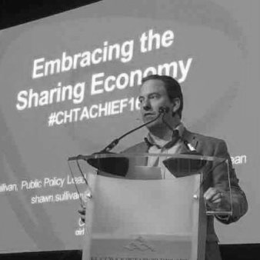
<
>
HOW WE IMPACT POLICY
As a direct result of our first event where both Natalie Jaresko, Executive Director of the Fiscal Control Board, and Governor Rosello were present, we were able to start effecting policy change:
MAY 30
Tom Loosemore
Former Deputy Director of
UK Digital Service
Shawn Sullivan
Public Policy Director, Airbnb
Governor asked Fiscal Board to request USDS resources in PR
Fiscal Board makes USDS assistance part of fiscal plan
Governor signed a law to allow Airbnb to automatically collect the room tax
Notes:
Make life simple to improve outcome for governments. Go to estonia and UK and talk about the ‘big prize’ of government as a platform. Platform infrastructure for multiple services!
Geolocation data for organization.
Design patterns
simplicity
End with the big prize
Workshop
Procurement and how we transform it
Simplicity and mobile first, design patterns
Recruitment
ID ecosystem - what do we use and what is politically acceptable
Internet-era Service Design - examples of how you can me the most of having a multi-disciplinary approach redesigning services using internet era approaches.
Talking about SERVICE DESIGN
Registeres and data as an infrasctructure! Land ownership registry!!! Doing that and the capabilities in a country
Identity - worries Tom because it’s hard to do - gov gives you an ID and tests you the ID or you have self-sovereignID - accept starndard third party id issuance. Where are we on this journey?
Lets push for this? I have Key people!!!
Richard Carrion support?
Honduras land registry!
Use blockchain to explore the land registry
Notion of using criptography to prove ownership of things is good for land and company registry
Data as infrasctructure - the first country to go for this!!!!

Slide 5
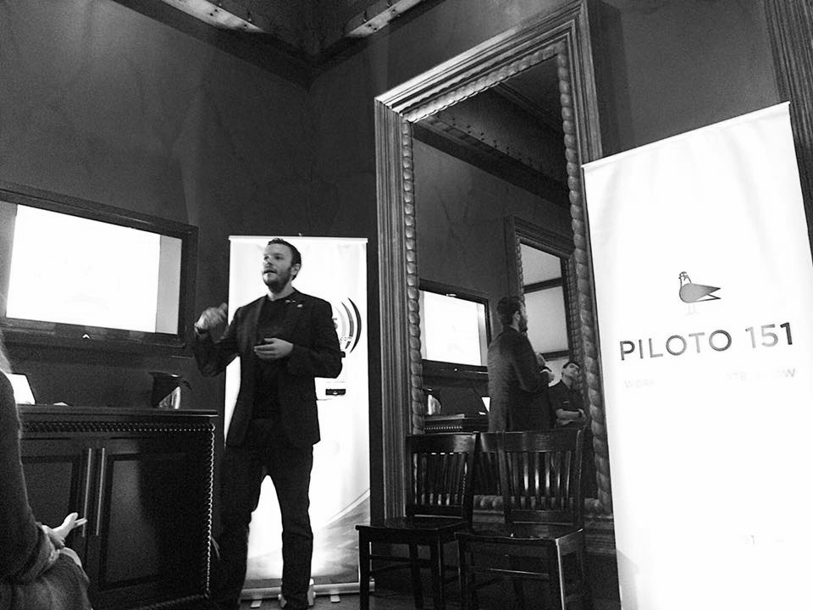
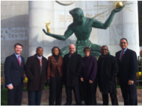
<
>
...BUT WE NEED TO DO MORE
We are currently advocating for the creation of a DIGITAL TASKFORCE - enabled through Congressional action - to assist the Puerto Rico government in procurement, IT spending & delivery of better services.
Notes:
Make life simple to improve outcome for governments. Go to estonia and UK and talk about the ‘big prize’ of government as a platform. Platform infrastructure for multiple services!
Geolocation data for organization.
Design patterns
simplicity
End with the big prize
Workshop
Procurement and how we transform it
Simplicity and mobile first, design patterns
Recruitment
ID ecosystem - what do we use and what is politically acceptable
Internet-era Service Design - examples of how you can me the most of having a multi-disciplinary approach redesigning services using internet era approaches.
Talking about SERVICE DESIGN
Registeres and data as an infrasctructure! Land ownership registry!!! Doing that and the capabilities in a country
Identity - worries Tom because it’s hard to do - gov gives you an ID and tests you the ID or you have self-sovereignID - accept starndard third party id issuance. Where are we on this journey?
Lets push for this? I have Key people!!!
Richard Carrion support?
Honduras land registry!
Use blockchain to explore the land registry
Notion of using criptography to prove ownership of things is good for land and company registry
Data as infrasctructure - the first country to go for this!!!!

Slide 6
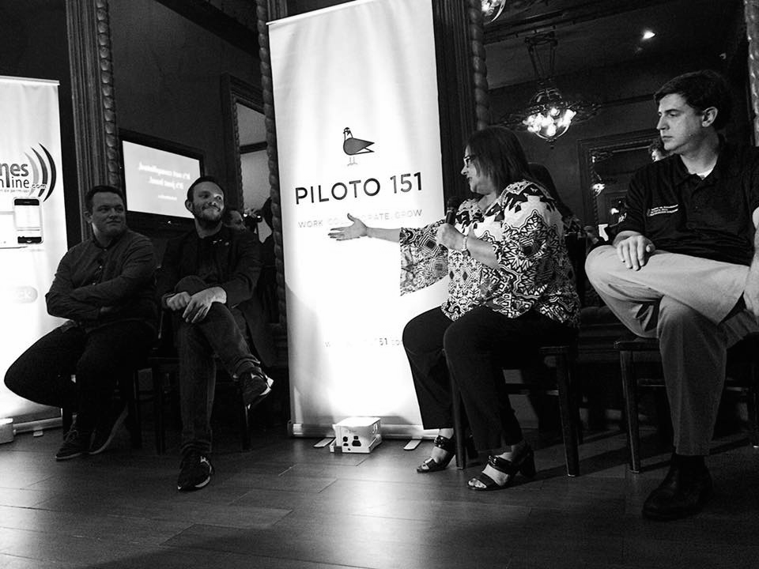

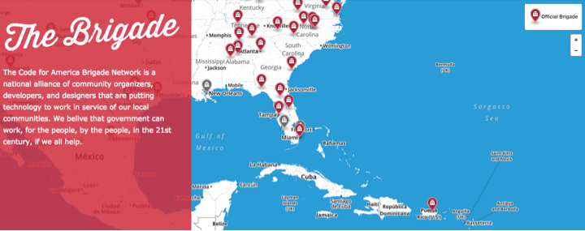
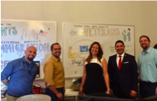
<
>
THE COMMUNITY IS ENGAGING
Notes:
Make life simple to improve outcome for governments. Go to estonia and UK and talk about the ‘big prize’ of government as a platform. Platform infrastructure for multiple services!
Geolocation data for organization.
Design patterns
simplicity
End with the big prize
Workshop
Procurement and how we transform it
Simplicity and mobile first, design patterns
Recruitment
ID ecosystem - what do we use and what is politically acceptable
Internet-era Service Design - examples of how you can me the most of having a multi-disciplinary approach redesigning services using internet era approaches.
Talking about SERVICE DESIGN
Registeres and data as an infrasctructure! Land ownership registry!!! Doing that and the capabilities in a country
Identity - worries Tom because it’s hard to do - gov gives you an ID and tests you the ID or you have self-sovereignID - accept starndard third party id issuance. Where are we on this journey?
Lets push for this? I have Key people!!!
Richard Carrion support?
Honduras land registry!
Use blockchain to explore the land registry
Notion of using criptography to prove ownership of things is good for land and company registry
Data as infrasctructure - the first country to go for this!!!!

Slide 7
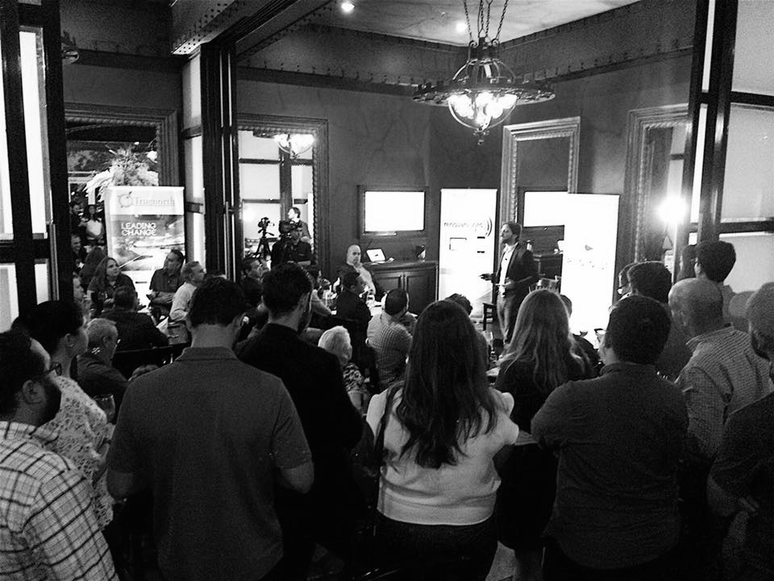

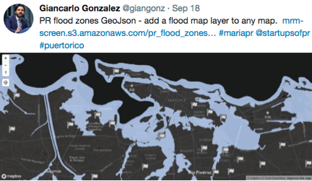
<
>
AND DELIVERING RESULTS...
Notes:
Make life simple to improve outcome for governments. Go to estonia and UK and talk about the ‘big prize’ of government as a platform. Platform infrastructure for multiple services!
Geolocation data for organization.
Design patterns
simplicity
End with the big prize
Workshop
Procurement and how we transform it
Simplicity and mobile first, design patterns
Recruitment
ID ecosystem - what do we use and what is politically acceptable
Internet-era Service Design - examples of how you can me the most of having a multi-disciplinary approach redesigning services using internet era approaches.
Talking about SERVICE DESIGN
Registeres and data as an infrasctructure! Land ownership registry!!! Doing that and the capabilities in a country
Identity - worries Tom because it’s hard to do - gov gives you an ID and tests you the ID or you have self-sovereignID - accept starndard third party id issuance. Where are we on this journey?
Lets push for this? I have Key people!!!
Richard Carrion support?
Honduras land registry!
Use blockchain to explore the land registry
Notion of using criptography to prove ownership of things is good for land and company registry
Data as infrasctructure - the first country to go for this!!!!

Slide 8
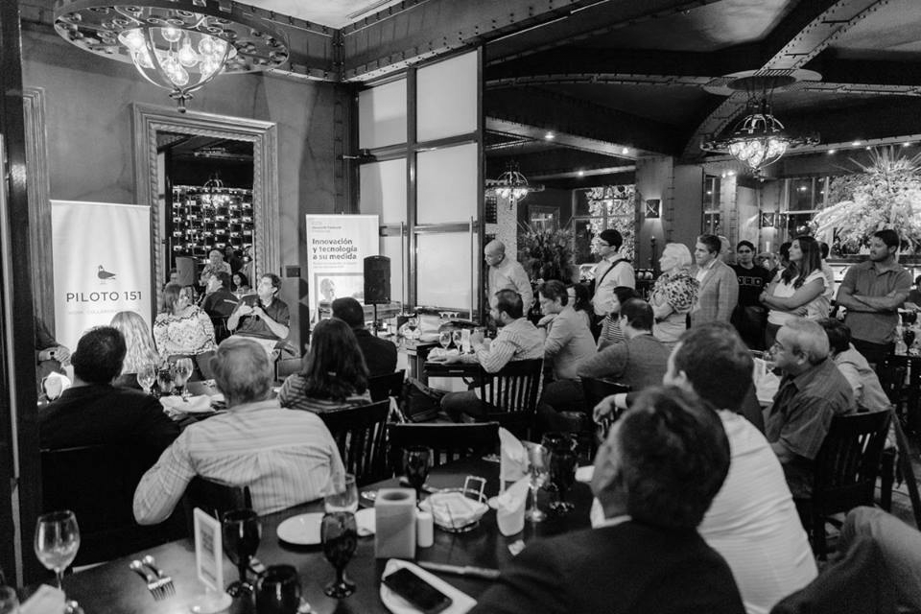
<
>
...BUT WE NEED TO DO MORE
We are working on a way to better leverage civic tech support and government use of technologies that are available.
We are finding ways to ensure the citizen is engaged and able to interact with the tools meant to help those in need.
Notes:
Make life simple to improve outcome for governments. Go to estonia and UK and talk about the ‘big prize’ of government as a platform. Platform infrastructure for multiple services!
Geolocation data for organization.
Design patterns
simplicity
End with the big prize
Workshop
Procurement and how we transform it
Simplicity and mobile first, design patterns
Recruitment
ID ecosystem - what do we use and what is politically acceptable
Internet-era Service Design - examples of how you can me the most of having a multi-disciplinary approach redesigning services using internet era approaches.
Talking about SERVICE DESIGN
Registeres and data as an infrasctructure! Land ownership registry!!! Doing that and the capabilities in a country
Identity - worries Tom because it’s hard to do - gov gives you an ID and tests you the ID or you have self-sovereignID - accept starndard third party id issuance. Where are we on this journey?
Lets push for this? I have Key people!!!
Richard Carrion support?
Honduras land registry!
Use blockchain to explore the land registry
Notion of using criptography to prove ownership of things is good for land and company registry
Data as infrasctructure - the first country to go for this!!!!

Slide 9


<
>
THE ECOSYSTEM IS HURTING...
We ran a poll from a popular facebook group of 2,800 programmers, asking them where they are and what their situation is:
54.76% I am in PR, no access to power or Internet and need work
25.00% I left PR, have power and Internet, need work
20.24% I am in PR, have access to power and Internet, need work
The technology sector is a key industry in Puerto Rico, one of the few that was thriving during the fiscal crisis.
Notes:
54.76% I am in PR, no access to power or Internet and need work 46
I left PR, have power and Internet, need work 21 25.00%
I am in PR, have access to power and Internet, need work 17 20.24%
Make life simple to improve outcome for governments. Go to estonia and UK and talk about the ‘big prize’ of government as a platform. Platform infrastructure for multiple services!
Geolocation data for organization.
Design patterns
simplicity
End with the big prize
Workshop
Procurement and how we transform it
Simplicity and mobile first, design patterns
Recruitment
ID ecosystem - what do we use and what is politically acceptable
Internet-era Service Design - examples of how you can me the most of having a multi-disciplinary approach redesigning services using internet era approaches.
Talking about SERVICE DESIGN
Registeres and data as an infrasctructure! Land ownership registry!!! Doing that and the capabilities in a country
Identity - worries Tom because it’s hard to do - gov gives you an ID and tests you the ID or you have self-sovereignID - accept starndard third party id issuance. Where are we on this journey?
Lets push for this? I have Key people!!!
Richard Carrion support?
Honduras land registry!
Use blockchain to explore the land registry
Notion of using criptography to prove ownership of things is good for land and company registry
Data as infrasctructure - the first country to go for this!!!!

Slide 10

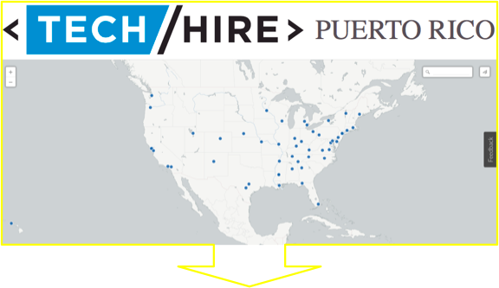
<
>
...AND WE NEED TO ACT NOW
Finding opportunities for our startups and freelancers to do remote work outside of PR will be increasingly important.
Notes:
Make life simple to improve outcome for governments. Go to estonia and UK and talk about the ‘big prize’ of government as a platform. Platform infrastructure for multiple services!
Geolocation data for organization.
Design patterns
simplicity
End with the big prize
Workshop
Procurement and how we transform it
Simplicity and mobile first, design patterns
Recruitment
ID ecosystem - what do we use and what is politically acceptable
Internet-era Service Design - examples of how you can me the most of having a multi-disciplinary approach redesigning services using internet era approaches.
Talking about SERVICE DESIGN
Registeres and data as an infrasctructure! Land ownership registry!!! Doing that and the capabilities in a country
Identity - worries Tom because it’s hard to do - gov gives you an ID and tests you the ID or you have self-sovereignID - accept starndard third party id issuance. Where are we on this journey?
Lets push for this? I have Key people!!!
Richard Carrion support?
Honduras land registry!
Use blockchain to explore the land registry
Notion of using criptography to prove ownership of things is good for land and company registry
Data as infrasctructure - the first country to go for this!!!!

Slide 11


WHO HAS PARTICIPATED IN DFB?
MAY 30
Tom Loosemore
Former Deputy Director of
UK Digital Service
Shawn Sullivan
Public Policy Director, Airbnb
Dan Sheldon
Former Digital Lead
UK Dept of Health
SEP 8
Maksim Pecherskiy
Chief Data Officer
City of San Diego

Slide 12



WHO IS IN OUR NOV 16 LINEUP?
Bill Cooper
Lead drafter of and negotiator for the Puerto Rico Oversight, Management, and Economic Stability Act
Froilan Irizarry
Former at US Digital Service
Leader Maria Tech Brigade
Vivian Graubard
Director of Strategy / Public Interest Tech
New America
Carlos Mercader
Executive Director
Puerto Rico Federal Affairs
Administration
Alberto Colon
US Digital Service
Leader Maria Tech Brigade

Slide 13
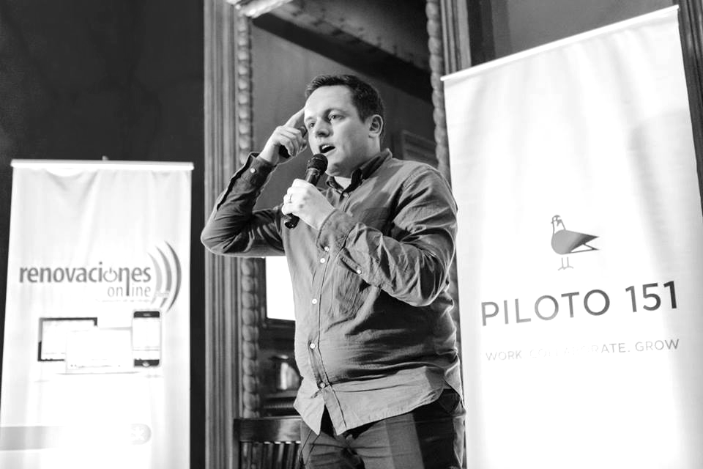
“You cannot rebuild a country properly if the elites don’t understand technology in the same way they grasp economics or ideology or propaganda… What good governance and the good society look like is now inextricably linked to an understanding of the digital.”

